Slide 1
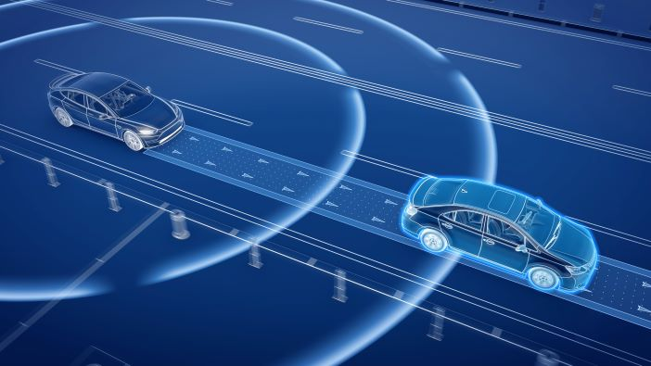
Detecting Collisions
By Shashank Garikipati on 6/28/2022

Slide 2
This presentation is organized as follows
Motivations
Dataset point association
Basic dataset plotting functions
K-nearest-Neighbor algorithm
Associated Data Statistics and Modifications
All about patches
Vehicle collision detection
Basic vehicle definitions
Construction zones and obstacles
Straight path collision detection
Curved path collision detection

Slide 3
Motivations

Slide 4

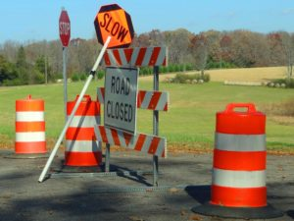
The dynamic and case-specific nature of construction work zones makes it especially difficult for autonomous vehicles to navigate through them
Some objects found in a work zone (not an exhaustive list)
[morrisseylawfirm.com]
[Freepik.com]

Slide 5
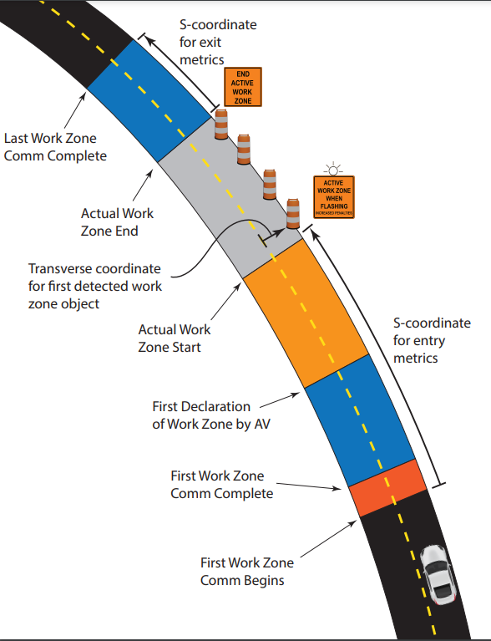
Construction work zones take various shapes, and tend to have various collidable objects on and near roads
It is important to be able to quickly and accurately detect objects that can potentially collide into the car

Slide 6
Basic Dataset Plotting Functions

Slide 7
A function in the Feature Extraction library allows users to XY datasets
Adapted from fcn_Path_plotTraversalsXY function in the path library
Function: fcn_Points_plotSetsXY.m
Script: script_test_fcn_Points_plotSetsXY.m

Slide 8
Users can create their own XY data using a function in this library
Function was adapted from fcn_Path_fillPathViaUserInputs from the path library
This is a function for the user to click on the figure to generate XY path. Points are collected and plotted until the user double clicks.
Function: fcn_Points_fillPointSetViaUserInputs.m
Script: script_test_fcn_Path_fillPathViaUserInputs.m

Slide 9
K-Nearest-Neighbor Algorithm

Slide 10
Associating XY points in one dataset (A map) to another dataset (waypoints) is a useful tool when working with construction zones
Plot showing association of points

Slide 11
X,Y points from two different datasets can be paired as an application of machine leaning (k-nearest neighbor algorithm)
Function: fcn_Points_pairXYdata.m
Script: script_test_fcn_Points_pairXYdata.m
Zoomed in version of the plot on the previous slide

Slide 12
In this problem, we want to associate X,Y data points in one data set (a map, for example) with X,Y data points in another data set
The data sets are not assumed to be sorted or have the same number of points.
A graphical depiction is given for two data sets here:
Data Set A
Data Set B

Slide 13
Association of XY points to XY points
Data Set A
Data Set B
The data sets are likely to have some points that are “mutual matches” where a pair of points in set A and set B are each the closest point to the point in the opposing data set.
The data sets are also likely to have points that do not have a close match once all of the mutual matches have been assigned.

Slide 14
Nearest-neighbor or k-nearest-neighbor (kNN) searches are well-researched machine learning algorithms that can help determine mutual matches
MATLAB implementation: [idx, dist] = knnsearch(datasetA, datasetB);
The kNN search will return a vector of indices that indicate the nearest neighbor in datasetA to each point in datasetB.
This can be modified to return a matrix of multiple (k) nearest neighbors for each point in datasetB.
https://www.mathworks.com/help/stats/knnsearch.html
Requires: Statistics and Machine Learning Toolbox

Slide 15
There may be points in set A that are the closest for multiple points in set B, or points that are never identified as a nearest neighbor.
Duplicate
neighbor
Not a
neighbor
Data Set A
Data Set B

Slide 16
How the algorithm works
Apply 1NN search to find the nearest neighbors in both directions
Compare returned indices to determine which points have mutual matches
Data Set A
Data Set A
Data Set B
Data Set B
Data Set A
Data Set A
Data Set B
Data Set B

Slide 17
How the algorithm works (continued)
Check each mutual match the distance is less than a radial limit
Reorganize (or copy) the matched points in Data Set A and Data Set B into a matrix where each row contains the X and Y coordinates of the two points
Optionally, append each of the unmatched points in Data Set A with padding in the last two columns since there aren’t matches in Data Set B
Optionally, append each of the unmatched points in Data Set B with padding in the first two columns since there aren’t matches in Data Set A
Data Set A
Data Set A
Data Set B
Data Set B

Slide 18
Associated Data Statistics and Modifications

Slide 19
It is useful to have some statistics for points in datasets that have been associated with each other
RMS Error: the RMS distances associated with the point-to-point match errors
Variance Error: the variance in the point-to-point match error distances
Mean Shift: the [X Y] shift that would cause the centroids of the two data sets to match
A function in the library helps us do this
Function: fcn_Points_calcPairStatistics.m
Script: script_test_fcn_Points_calcPairStatistics.m

Slide 20
Another function allows us to modify the statistics of datasets by adjusting XY points
Function: fcn_Points_adjustPointSetStatistics.m
Script: script_test_fcn_Points_adjustPointSetStatistics.m

Slide 21
Patches are used to represent objects that the vehicle can potentially collide into
Patches are represented as [1 x N] struct array in MATLAB
They are primarily defined by the x and y coordinates of their verticies inputted as two [M x 1] vectors for x and y, and a [1 x 3] RBG color vector.

Slide 22
Sample patches are used to illustrate how patched are implemented in the library
Function: fcn_Patch_fillSamplePatches.m
Script: No script yet

Slide 23
These patches can be easily visualized
Function: fcn_Patch_plotPatch.m
Script: script_test_fcn_Patch_plotPatch.m

Slide 24
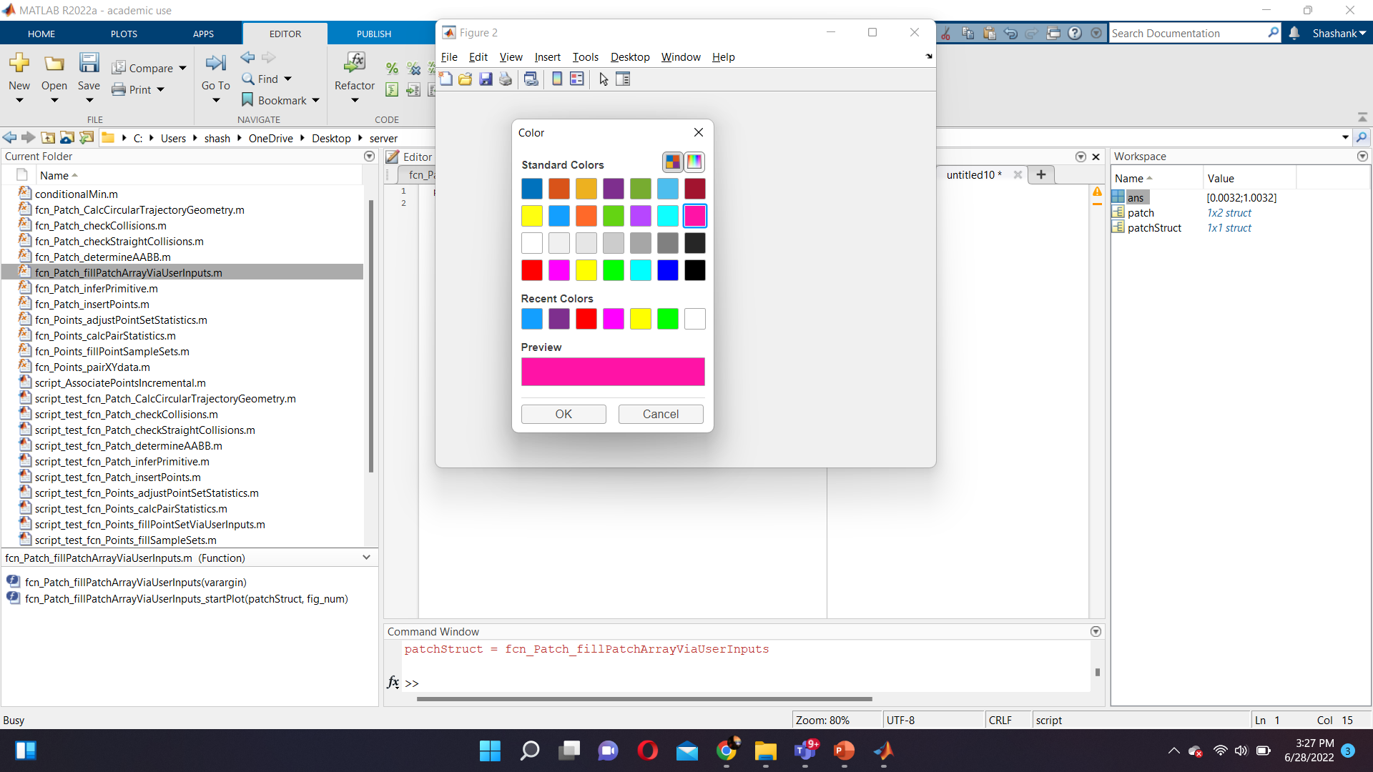
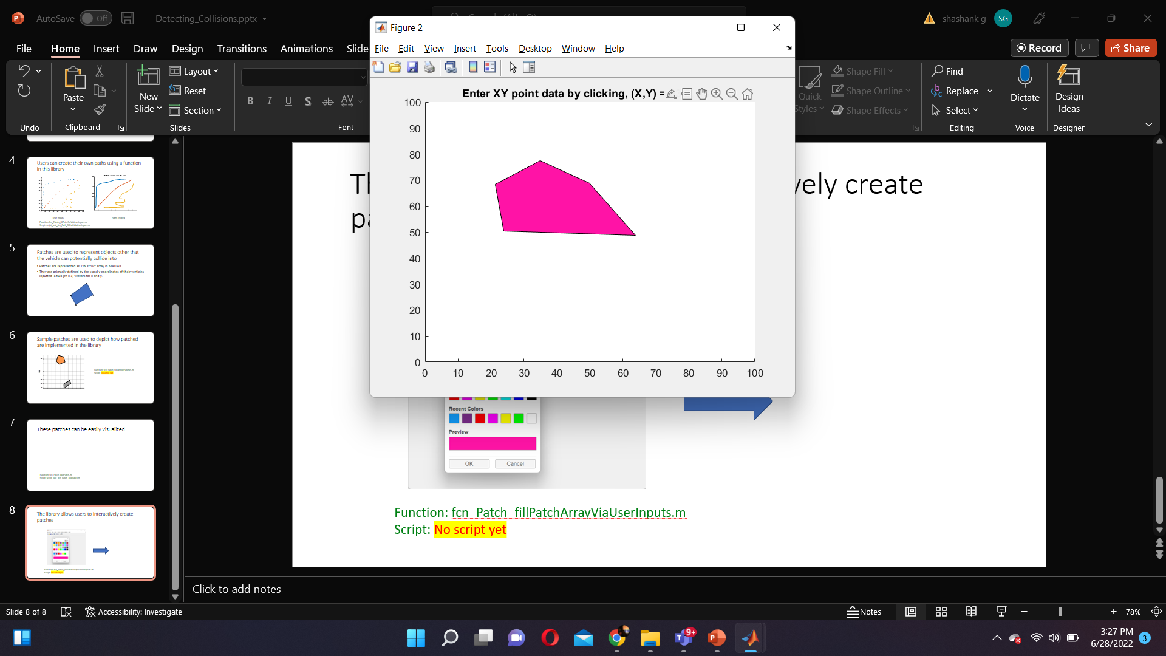
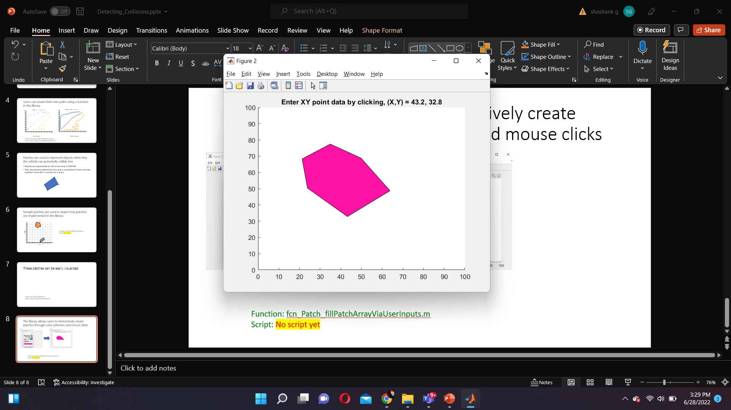
The library allows users to interactively create patches through color selection and mouse clicks
Function: fcn_Patch_fillPatchArrayViaUserInputs.m
Script: No script yet

Slide 25
Axis Aligned Bounding Boxes (AABB), which are useful when working with collision detection, can be determined for each of the patches
Function: fcn_Patch_determineAABB.m
Script: script_test_fcn_Patch_determineAABB.m

Slide 26
Basic Vehicle definitions

Slide 27
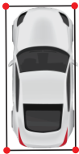
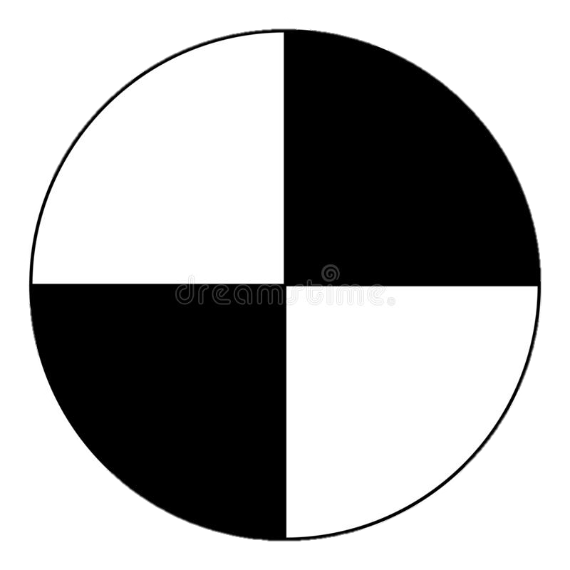
We define the following vehicle properties
CG-front bumper distance (df)
CG-rear bumper distance (dr)
Body width
= Center of Gravity (CG)

Slide 28
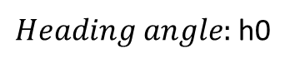
The heading angle is defined as the angle between the positive x axis and the heading (direction the vehicle is facing).
Heading
$Heading angle:$h0

Slide 29
Slip angle is the angle between the vehicle’s velocity vector and the heading
Vehicle velocity
Slip angle
Heading

Slide 30
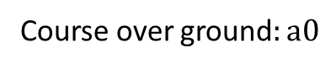
The heading angle is defined as the angle between the positive x axis and the vehicle’s velocity vector
Vehicle velocity
Course over ground$:a0$

Slide 31
Construction Zones and Obstacles

Slide 32
Construction work zones take various shapes, and tend to have various collidable objects on and near roads

Slide 33
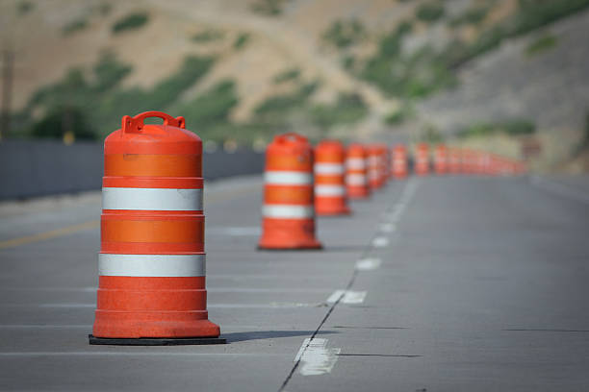
Common collidable objects found in construction sites are barrels, which from a top-down view can be modelled as regular octagon patches.
[istockphoto.com]
Function: fcn_Patch_fillBarrelAtPoint.m
Script: script_test_fcn_Patch_fillBarrelAtPoint.m

Slide 34
A function in the library enables the finding of the inner and outer radius of circular trajectory that the vehicle can clear without collision
It also returns the tangent point (given by the *)
of the inner limiting radii
Function: fcn_Patch_CalcCircularTrajectoryGeometry.m
Script: script_test_fcn_Patch_CalcCircularTrajectoryGeometry.m

Slide 35
Straight Path Collision Detection

Slide 36
Finding the collision points between obstacles and a vehicle travelling down a straight path
Function: fcn_Patch_checkStraightCollisions.m
Script: script_test_fcn_Patch_checkStraightCollisions.m

Slide 37
Important assumptions before we proceed to tackling the problem
We assume the collidable object to be in the shape of an arbitrary triangle
We assume the car to be approximated as a rectangle bounded by the maximum length and width of the car

Slide 38
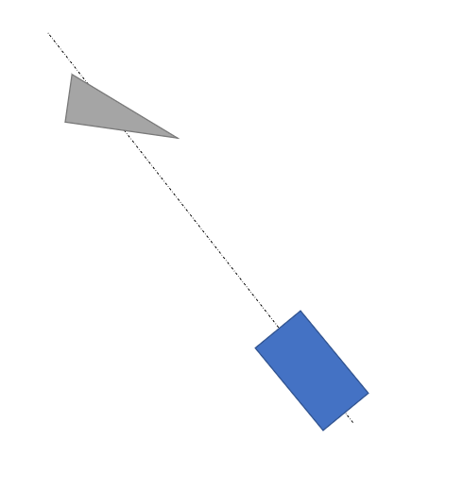
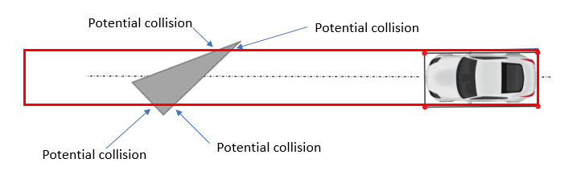
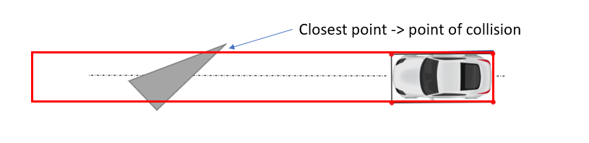
The strategy (explained in further details in upcoming slides)
Rotate (about CG) the vehicle and obstacles to point to the x-axis (to turn any situation into a standard problem) – use a rotation matrix
Use polyxpoly (matlab function to find intersection between two polylines) to find points of collision
We then check to see if there are any vertices of the object that lie on this rotated path
We then check to see if there have been any collisions by comparing the vertices and polyxpoly intersection points
collVertexInds = find(abs(rotObst(:,2)) < 1*vehicle.w/2 & rotObst(:,1) > -vehicle.dr);

Slide 39
Rotate (about CG) the vehicle and obstacles to point to the x-axis (to turn any situation into a standard problem) – use a rotation matrix

Slide 40
Use polyxpoly (matlab function to find intersection between two polylines) to find points of collision
We determine any obstacles that lie within or across the vehicle path on the positive the x-axis between the back of the vehicle (-vehicle.dr) and some large distance (1e6) (this area is given by the red box)
Potential collision
Potential collision
Potential collision
Potential collision
Link to polyxpoly documentation: https://www.mathworks.com/help/map/ref/polyxpoly.html

Slide 41
We then check to see if there are any vertices of the object that lie on this rotated path
collVertexInds = find(abs(rotObst(:,2)) < 1*vehicle.w/2 & rotObst(:,1) > -vehicle.dr);
Checking between x-axis between back of vehicle and come large distance
Checking within the width of the vehicle

Slide 42
We then check to see if there have been any collisions by comparing the points we obtained before
Closest point -> point of collision
If there is a collision, we compare whether the vertex was closer or polyxpoly point is closer. Which ever point is closer is the collision point.
If there is no collision, we try to find the minimum clearance and location of this on the obstacle.

Slide 43
Once this point is obtained, we rotate and translate it back to the original coordinate space
*
*
Collision point

Slide 44
There are several test cases that the algorithm can encounter
Collision with right edge
Collision with left edge
Collision with multiple objects’ edges

Slide 45
Collision with vertex
Collision with multiple objects’ vertex

Slide 46
The algorithm displays the location of the minimum clearances on the figure as near misses

Slide 47
We can also have these different test cases plotted as a single scenario

Slide 48
Curved Path Collision Detection

Slide 49
Finding the collision between a objects and a vehicle travelling down a curved patch
Something important to note is that a straight path is considered to be a curved path with an infinite radius, so any path can be treated as a curved path.
However, we consider the straight path to be a special case and use fcn_Patch_checkStraightCollisions.m for that case
Function: fcn_Patch_checkCollisions.m
Script: script_test_fcn_Patch_checkCollisions.m

Slide 50
The strategy (explained in further details in upcoming slides)
Define pertinent radii and calculate center of path radius circle
Convert from vehicle body coordinates to inertial coordinates using a rotation matrix
Checking to find intersection points between vehicle vertex and object edge
Checking to find intersection points object vertex and vehicle edge
Checking for collision by comparing obtained intersection points or calculating near misses

Slide 51
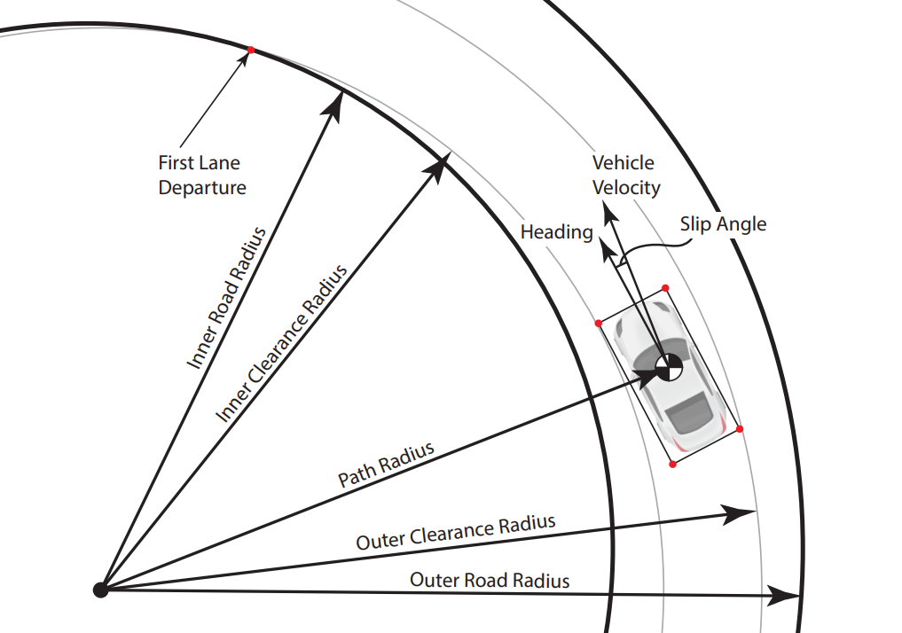
Vehicle trajectory for a curved path is defined by several pertinent radii

Slide 52
They are calculated as follows:
CG (circle) and CG path (black dash-dot line)
Front left and front right corner paths (gray lines)
Maximum clearance radius (blue line)
Minimum clearance radius (red line)
a

Slide 53
We changes the frame of reference to inertial coordinates with respect to the car by defining a rotation matrix (To be completed)
Rotation matrix = [cos(K) sin(K)
-sin(K) cos(K)]
K = initial course over ground (rad) + slip angle (rad) (in vehicle body coordinates)

Slide 54
Checking to find intersection points between vehicle vertex and object edge (To be completed)

Slide 55
Checking to find intersection points object vertex and vehicle edge (To be completed)

Slide 56
Checking for collision by comparing obtained intersection points or calculating near misses (To be completed)

Slide 57
Considering all the possible collision/near miss possibilities
 | Front of Car | Inside of Car | Outside of Car
Vertex within track width | Direct calculation of vertex angle relative to center | N/A | N/A
Vertex between inside front corner and min radius | N/A | Calculate distance ahead of CG for collision then offset from vertex angle | N/A
Vertex between outside front corner and max radius | N/A | N/A | Calculate distance behind CG for collision then offset from vertex angle
Edge entirely within track width | Handled by vertex checks | N/A | N/A
Edge between min radius and track width | Handled by vertex check if track width vertex comes first | Circle/edge intersection check with inside front | N/A
Edge between max radius and track width | Handled by vertex check if track width vertex comes first | N/A | Circle/edge intersection check with outside front
Edge spans the track width but vertices within min and max radii | N/A unless edge is perfectly parallel to front of car | Circle/edge intersection check with inside front | Circle/edge intersection check with outside front
Edge spans min and max radii | N/A unless edge is perfectly parallel to front of car | Circle/edge intersection check with inside front | Circle/edge intersection check with outside front
Edge spans max radius with vertex outside of outer front track radius | N/A | N/A | Circle/edge intersection check with outside rear OR vertex check behind CG (depends on edge angle)
Edge spans min radius with vertex outside of inner front track radius | N/A | Vertex check ahead of CG | N/A
Vertices outside max/min radii (near miss) | N/A | Determine point with minimum difference from CG radius by vertices | Determine point with minimum difference from CG radius by vertices and nearest point on edges.

Slide 58
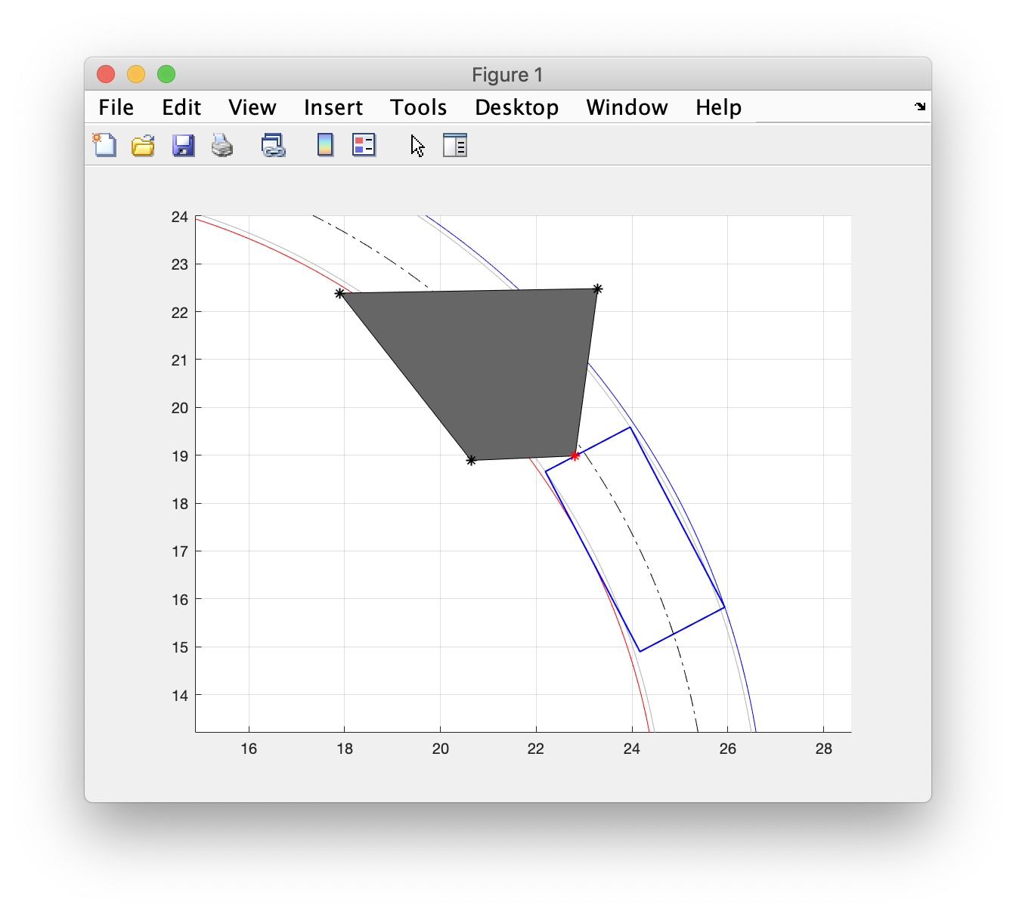
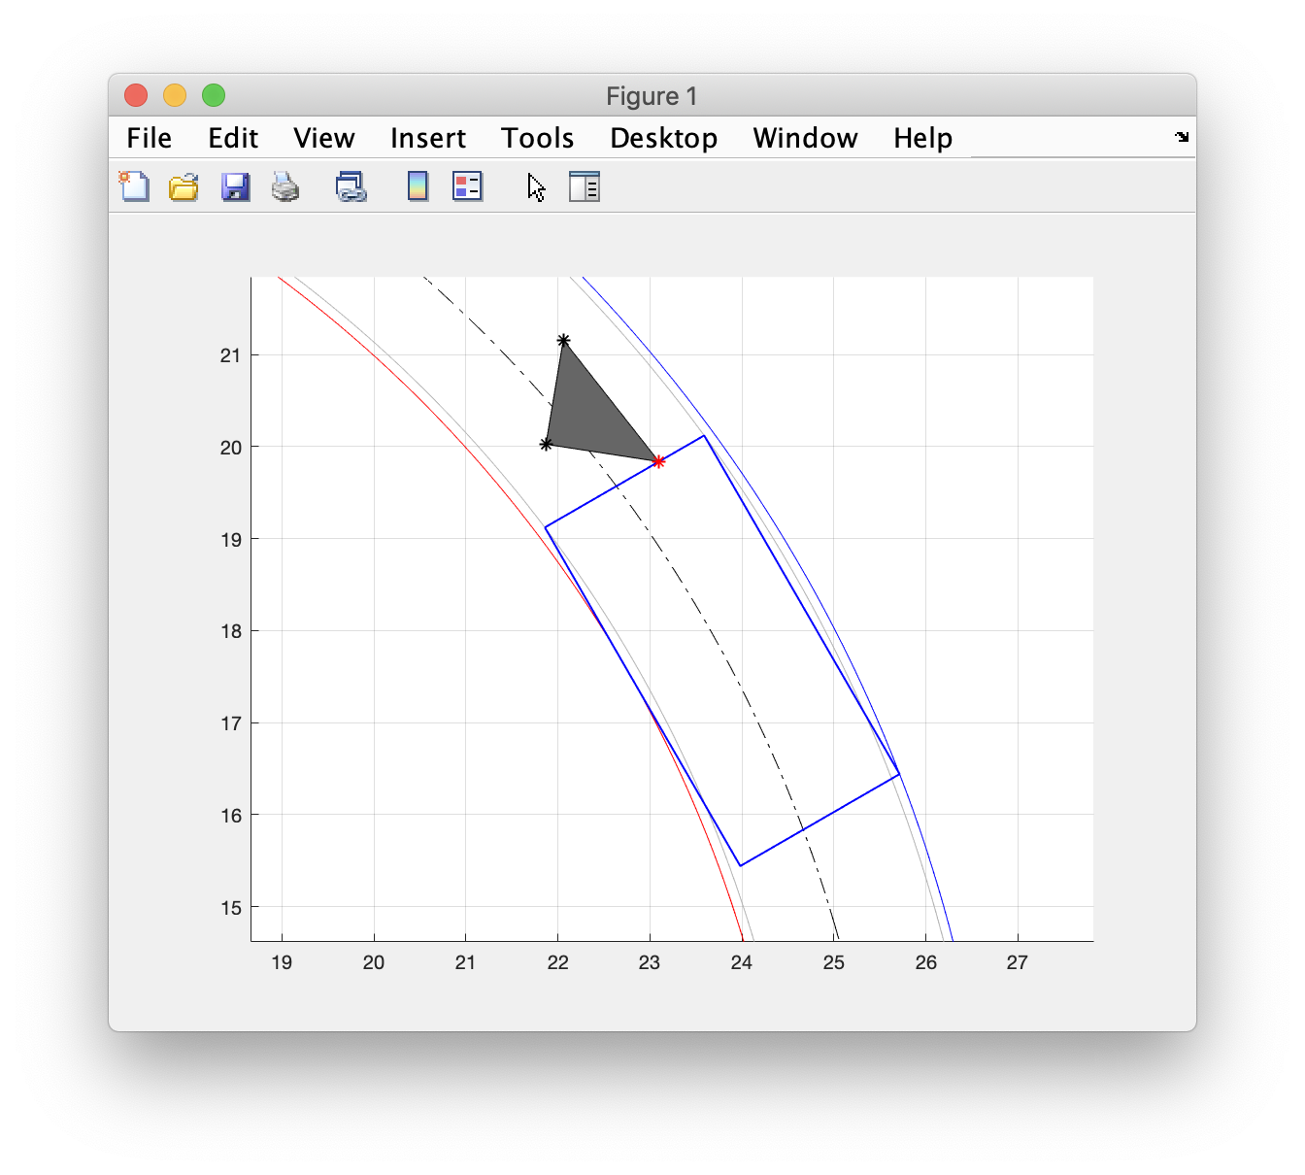
Vertex/vertices within track width

Slide 59
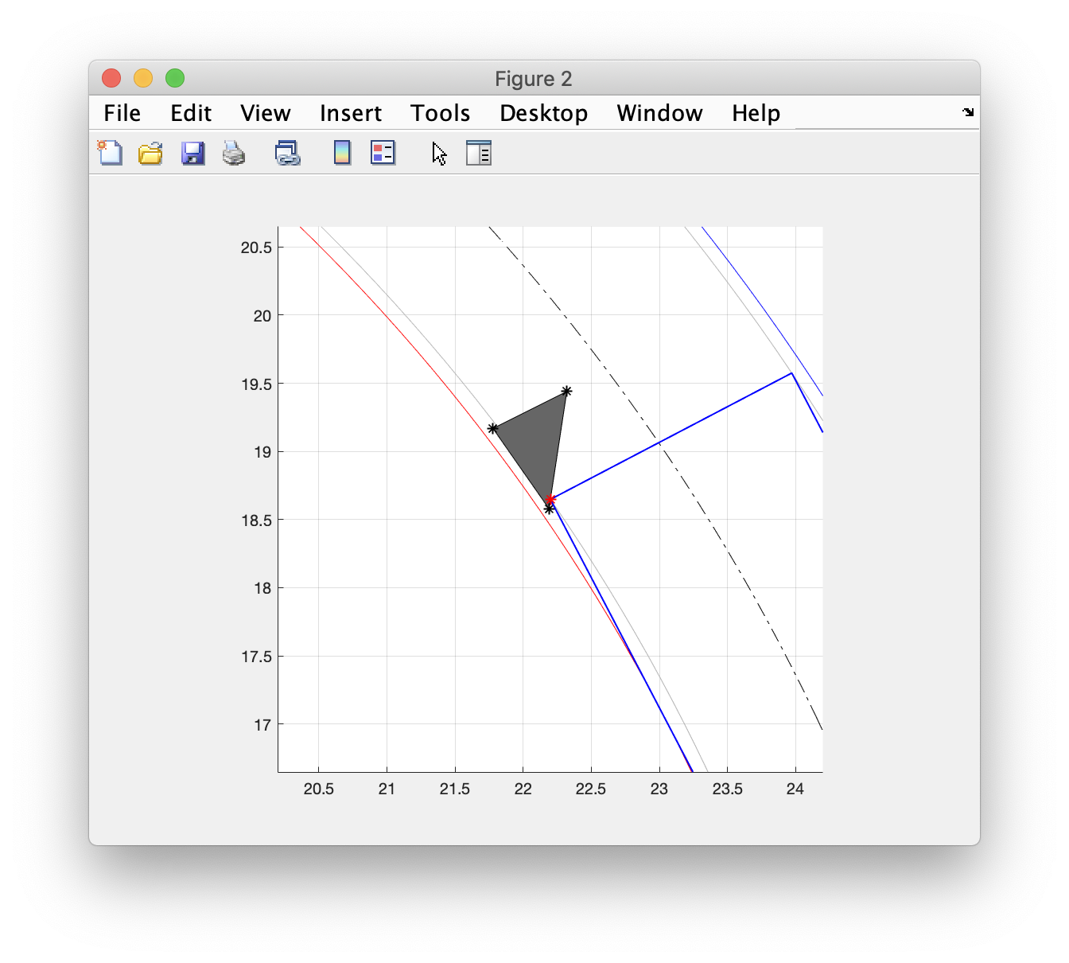
Vertex between inside front corner and min radius

Slide 60
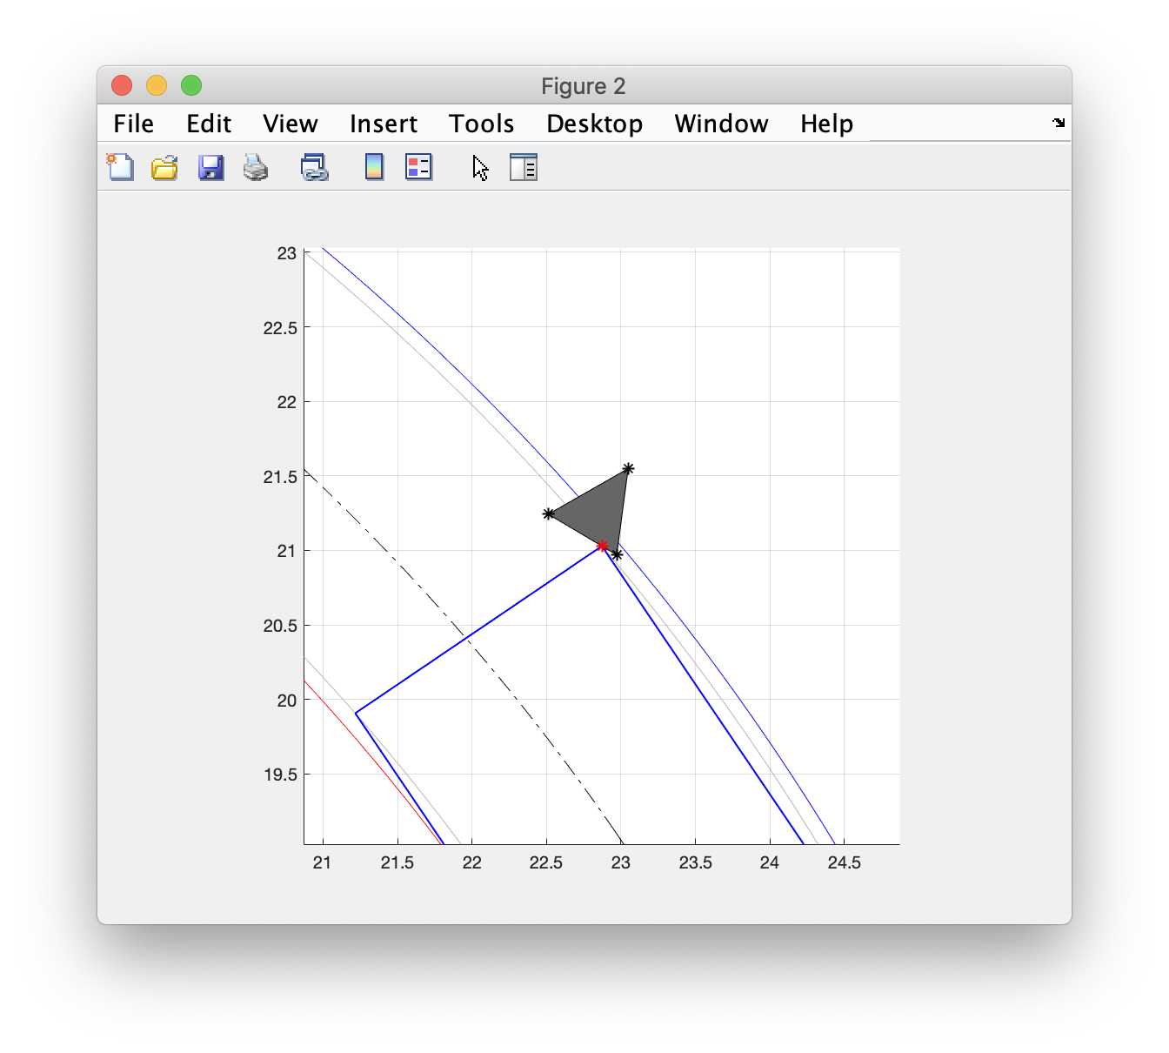
Vertex between outside front corner and max radius

Slide 61
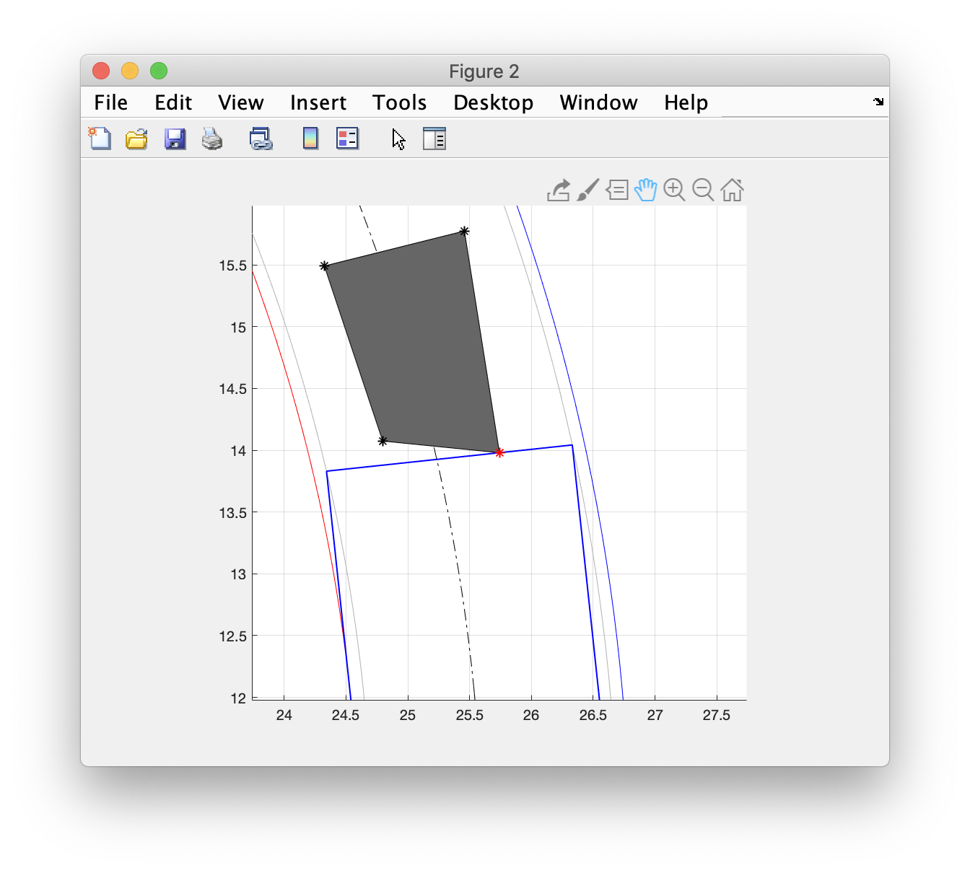
Edge entirely within track width

Slide 62
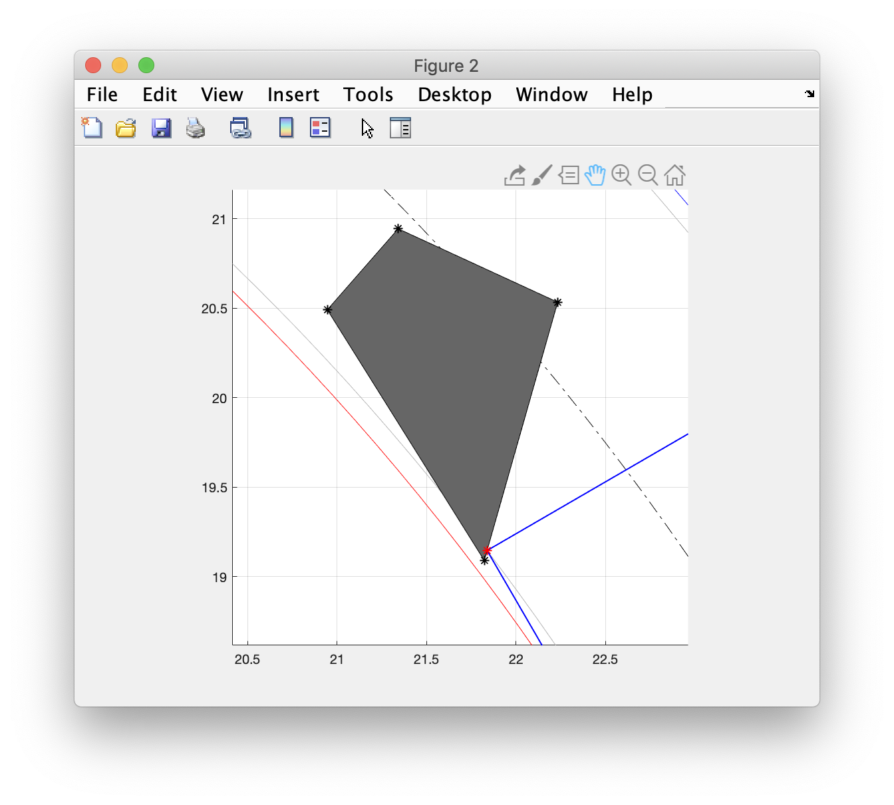
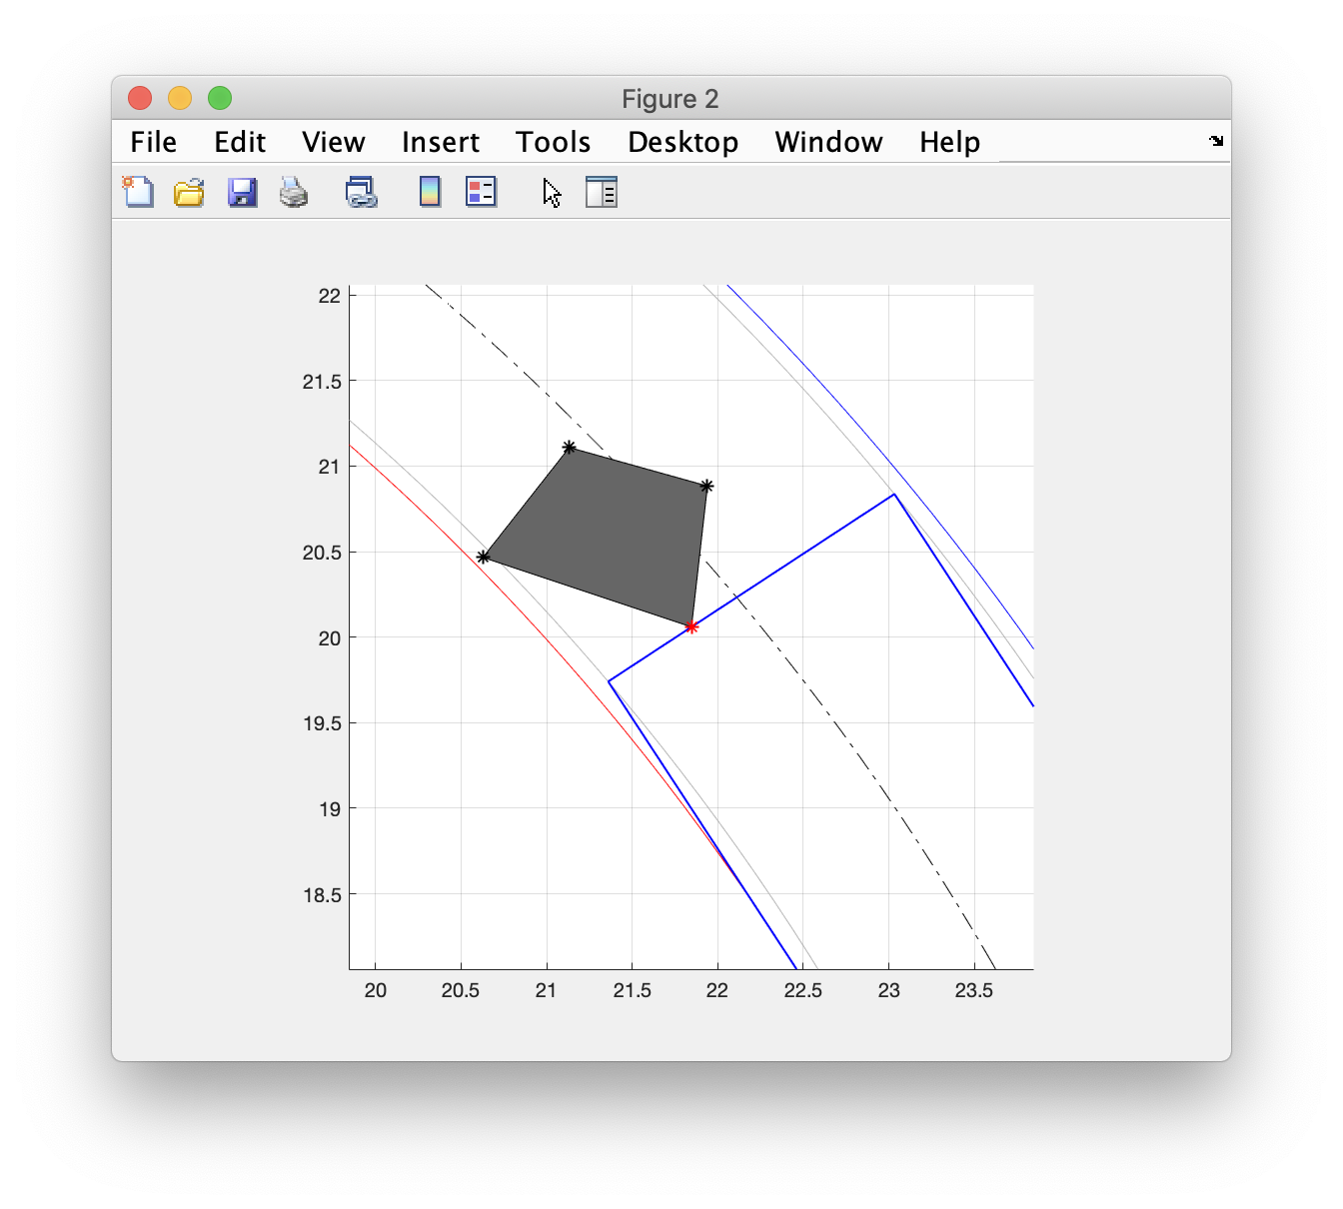
Edge between min radius and track width

Slide 63
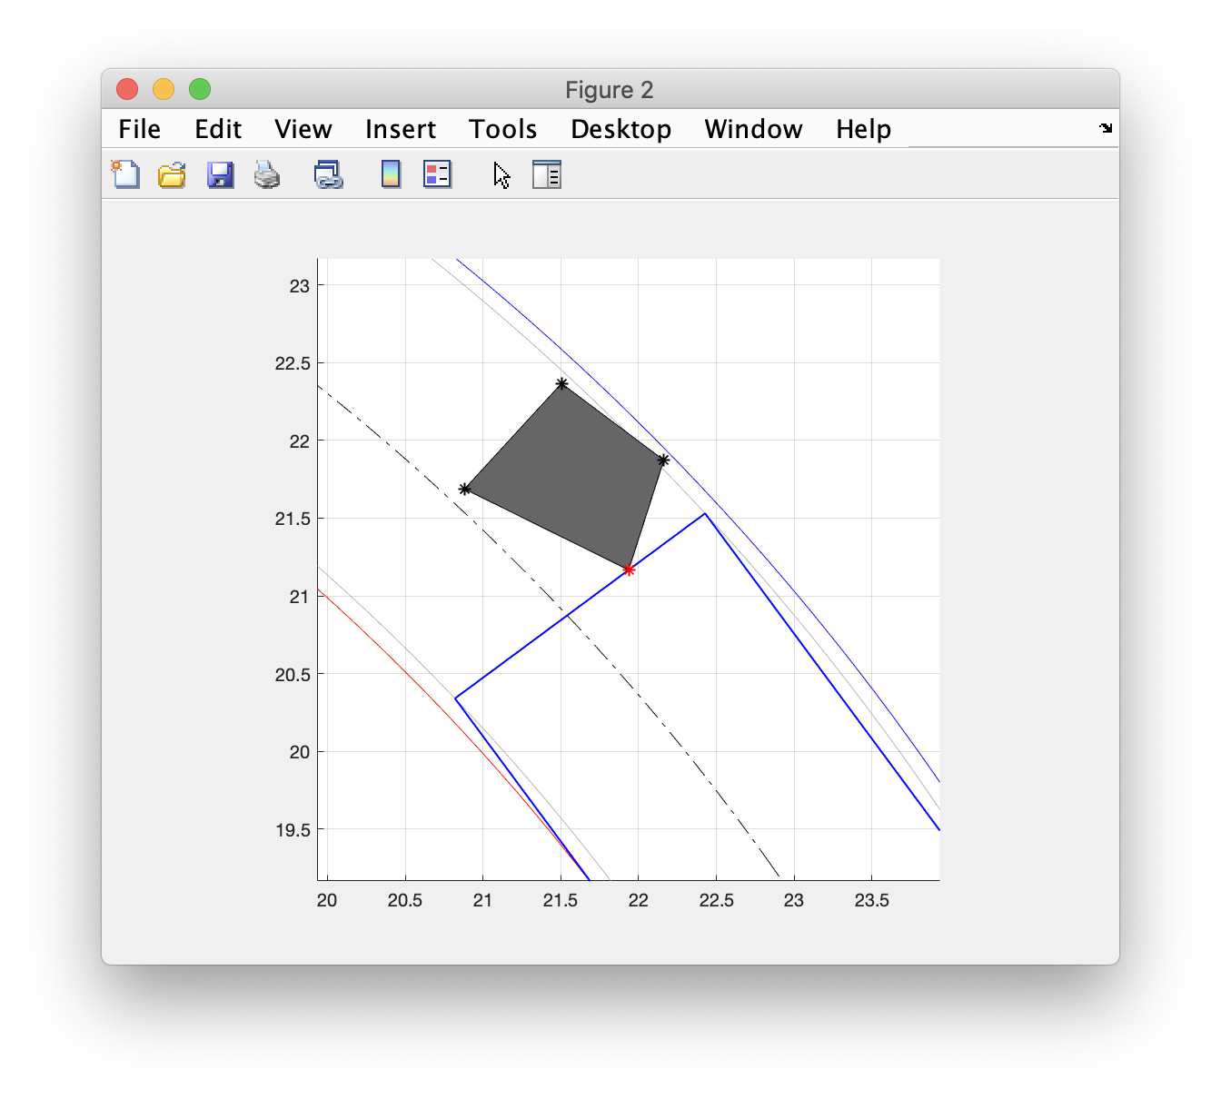
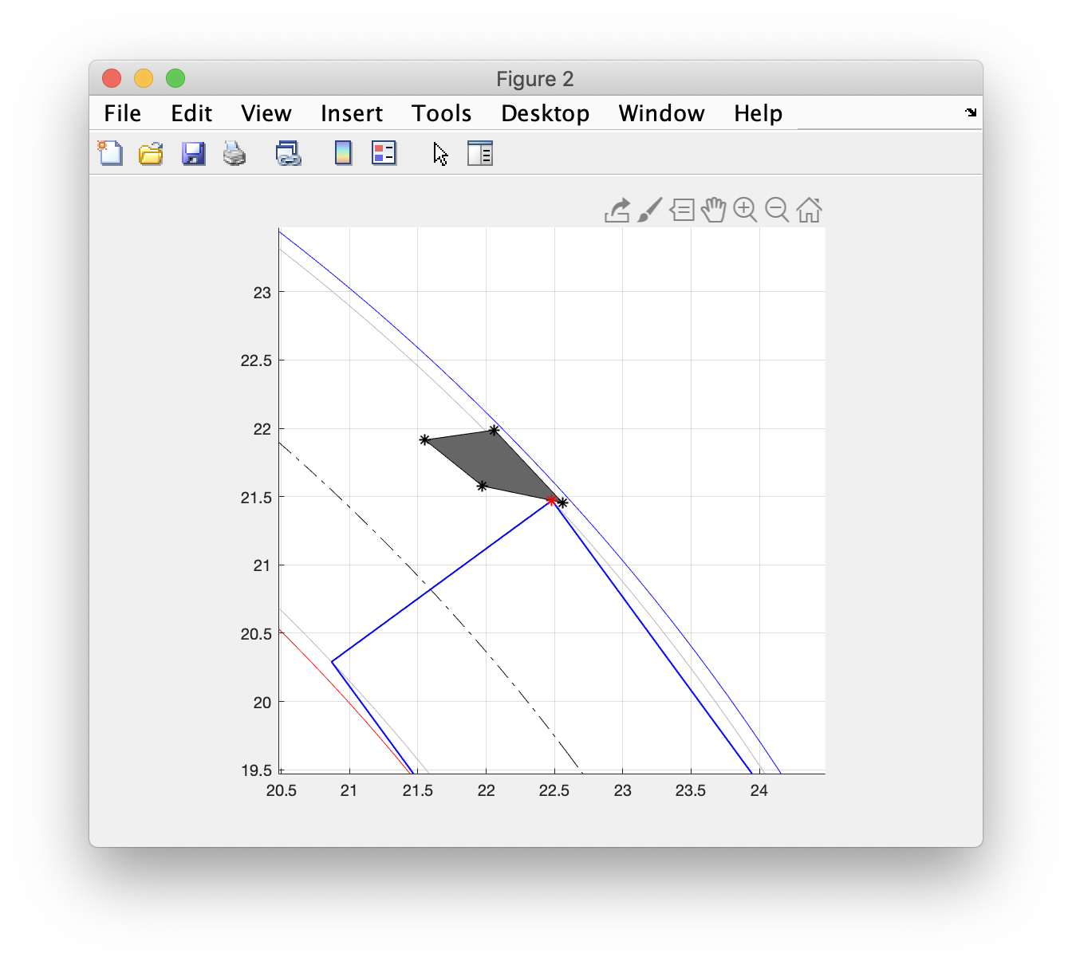
Edge between max radius and track width

Slide 64
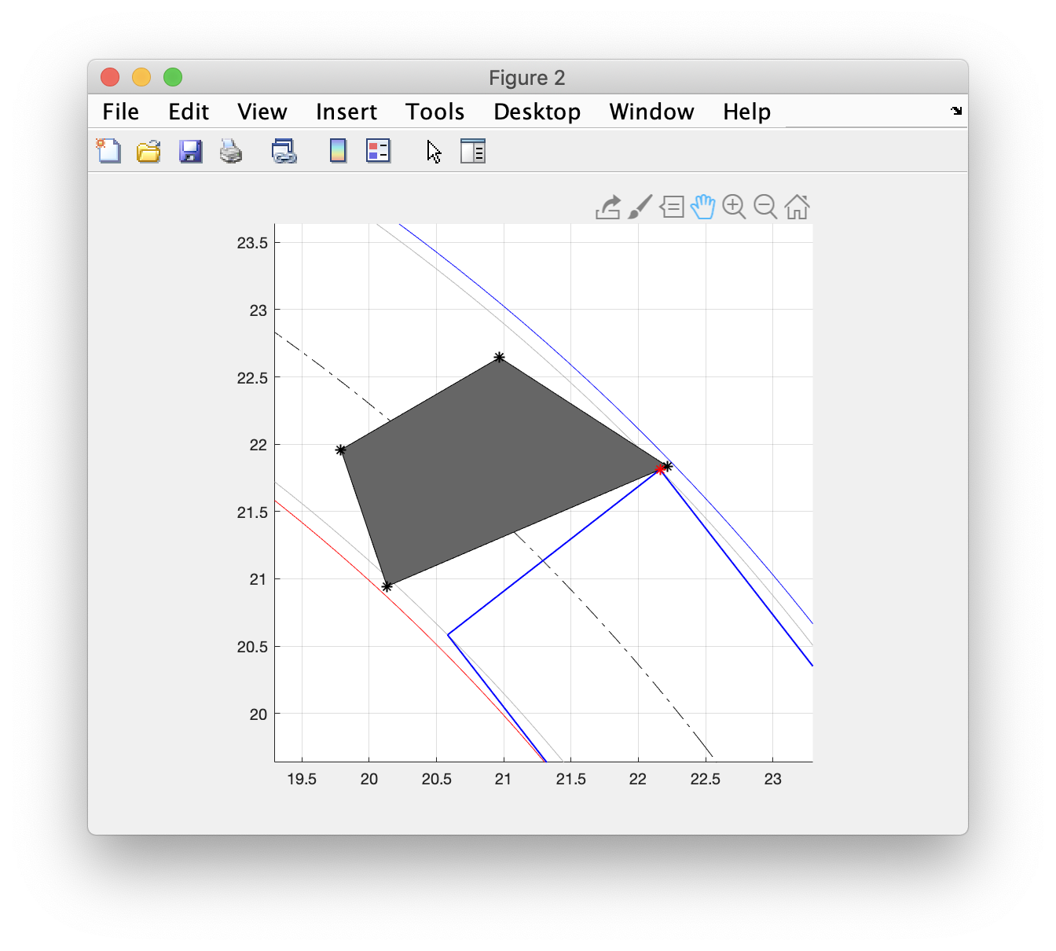
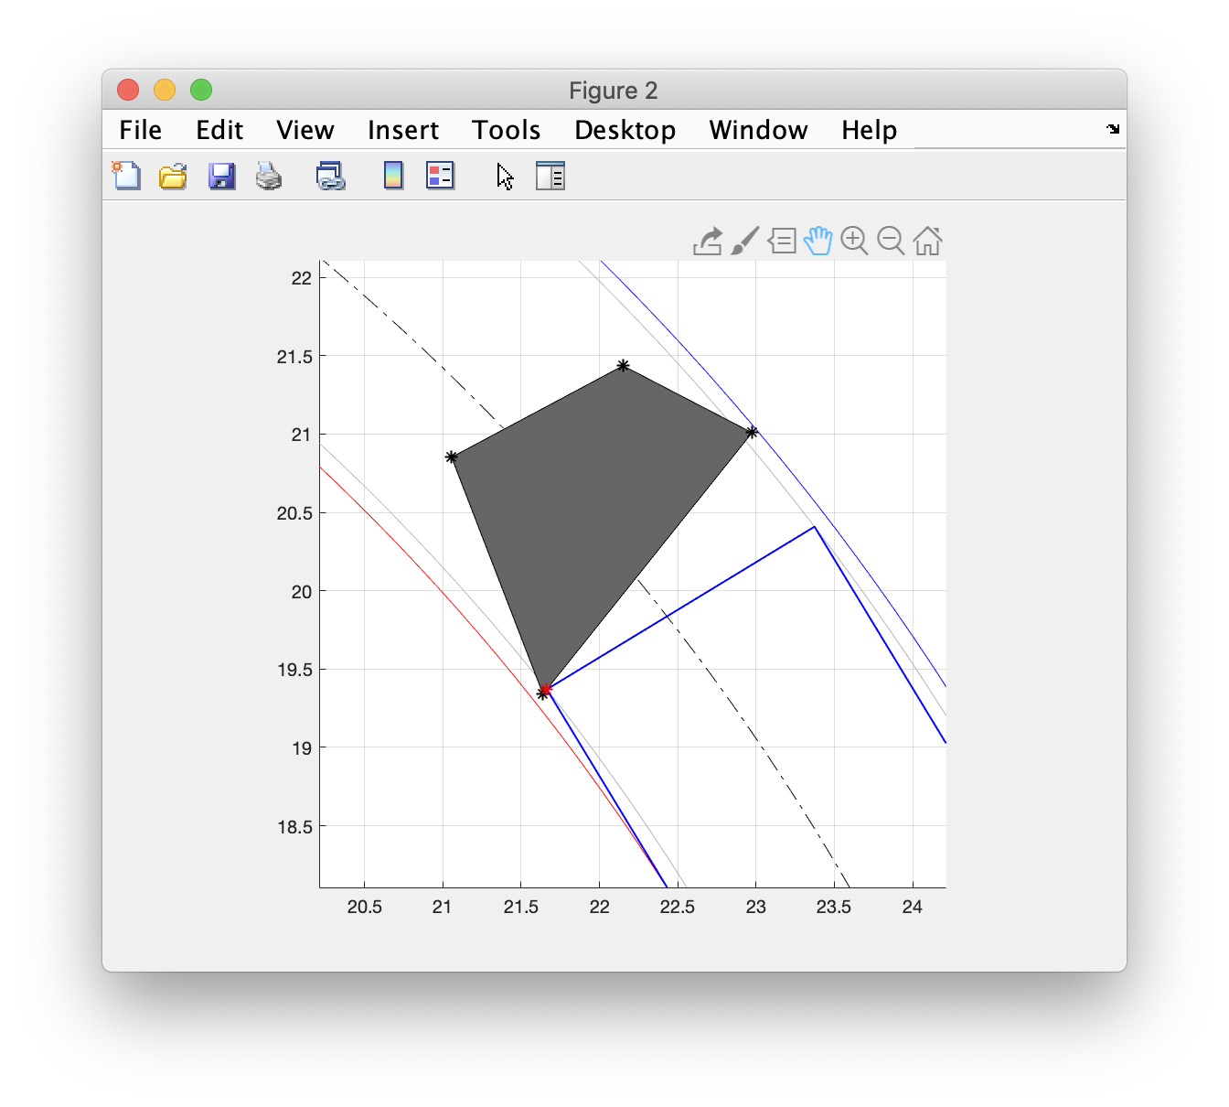
Edge spans the track width but vertices within min and max radii

Slide 65
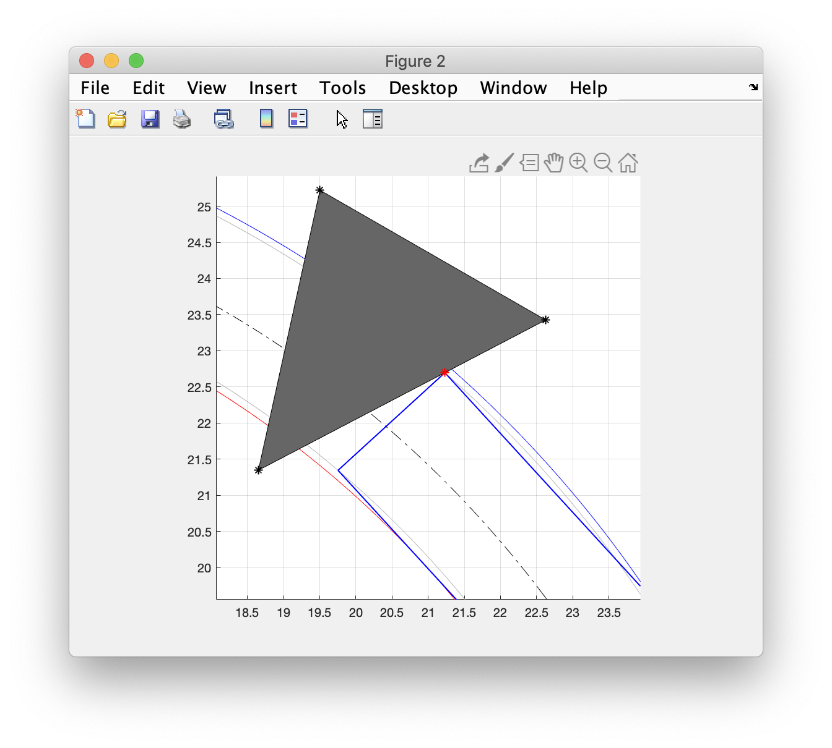
Edge spans min and max radii

Slide 66
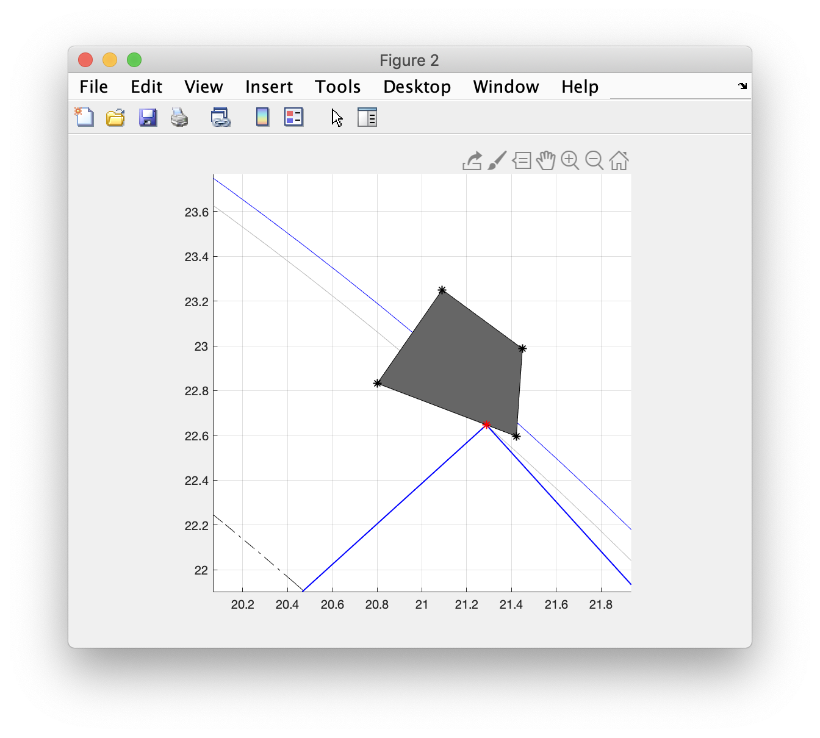
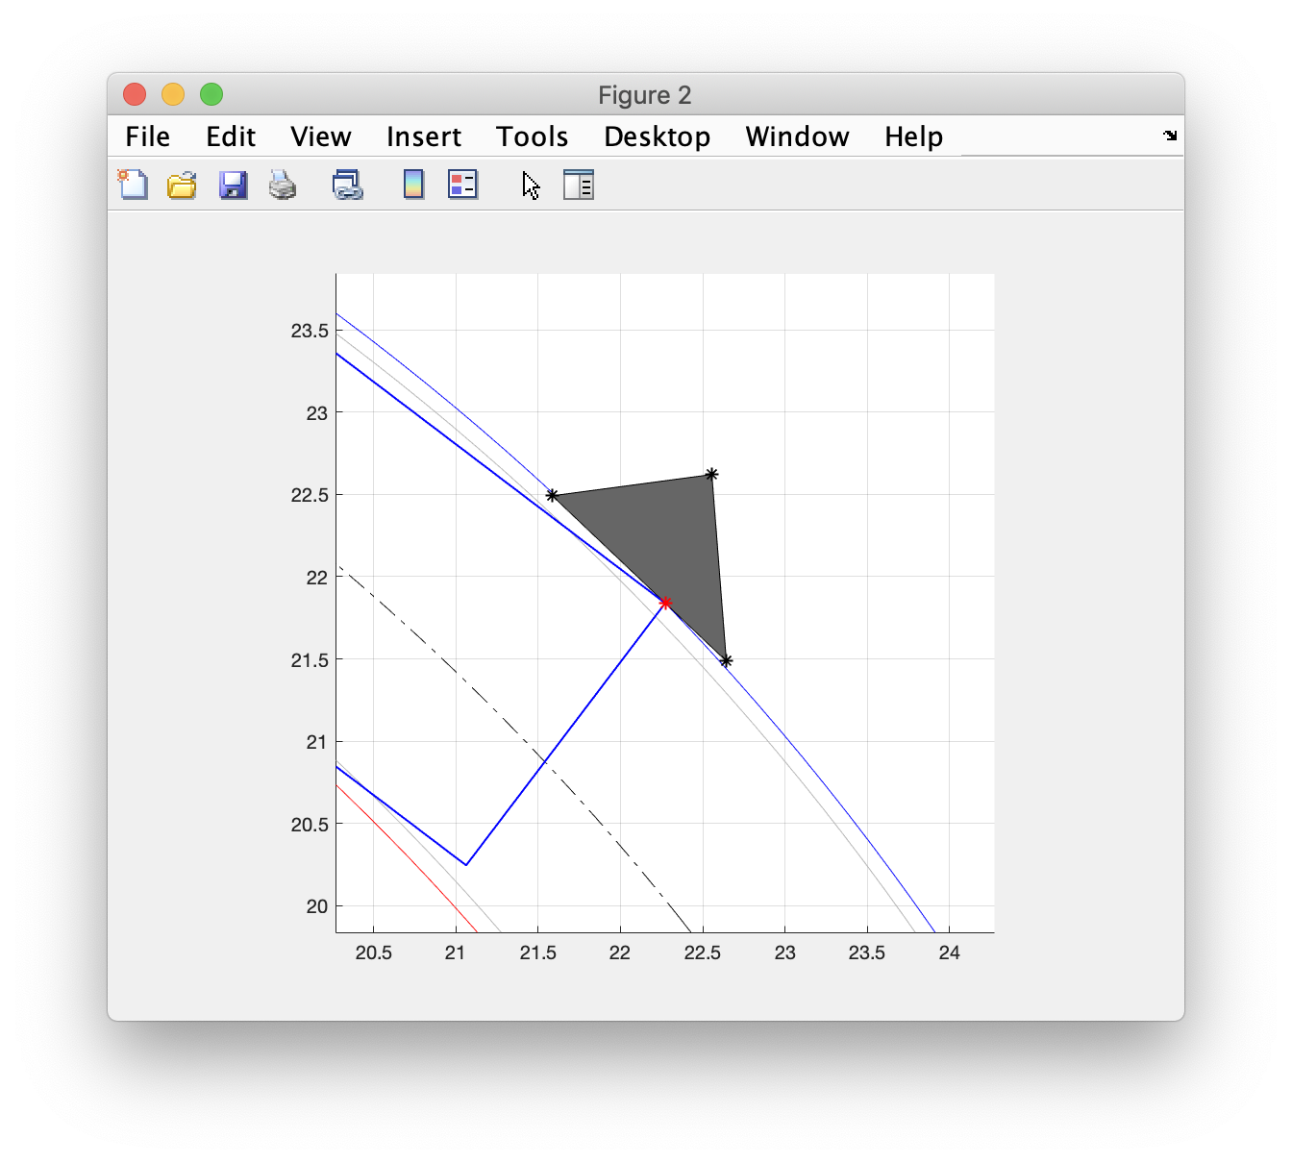
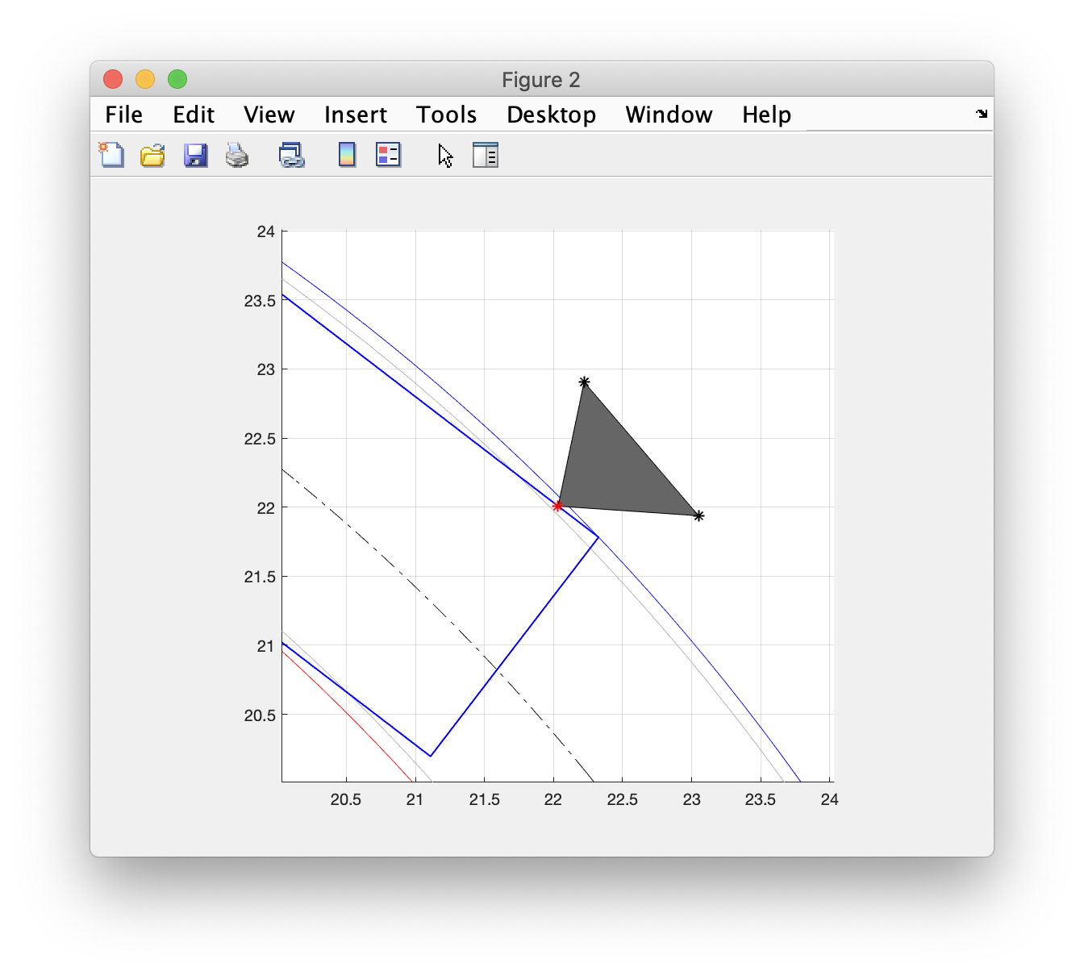
Edge spans max radius with vertex outside of outer front track radius

Slide 67
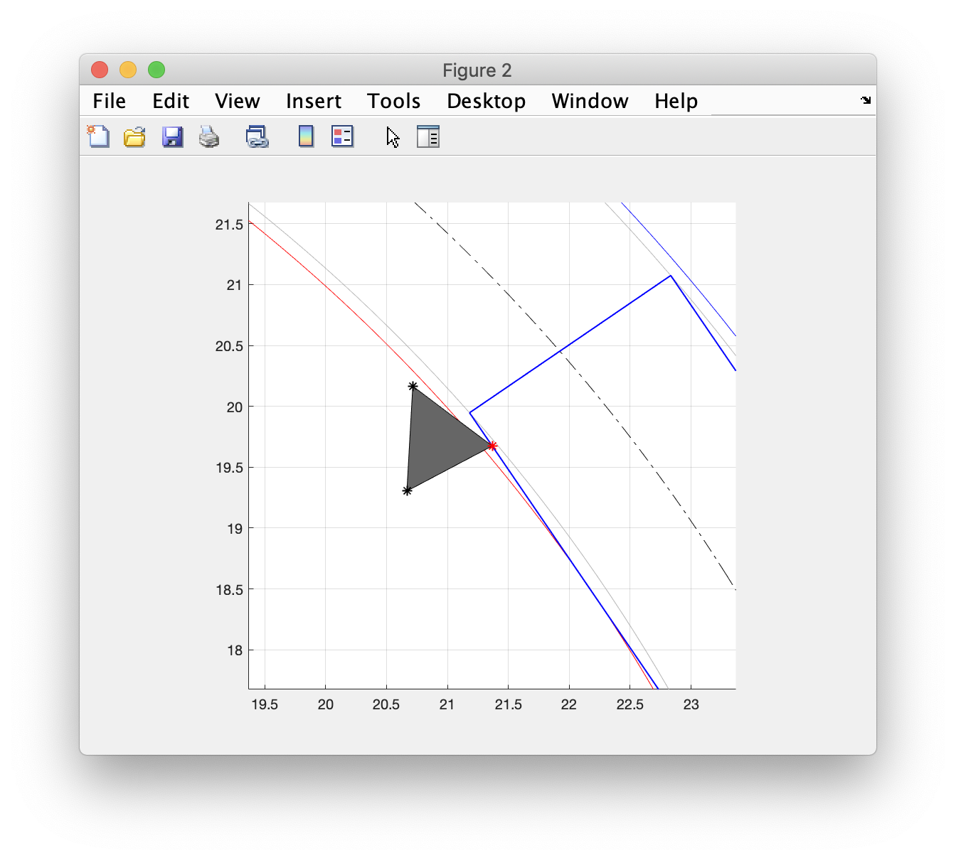
Edge spans min radius with vertex outside of inner front track radius

Slide 68
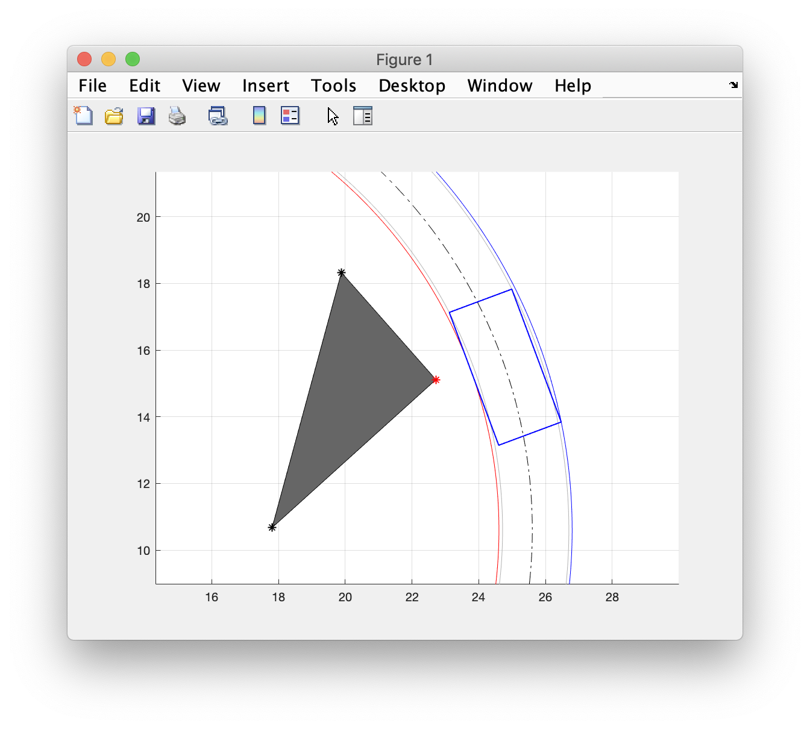
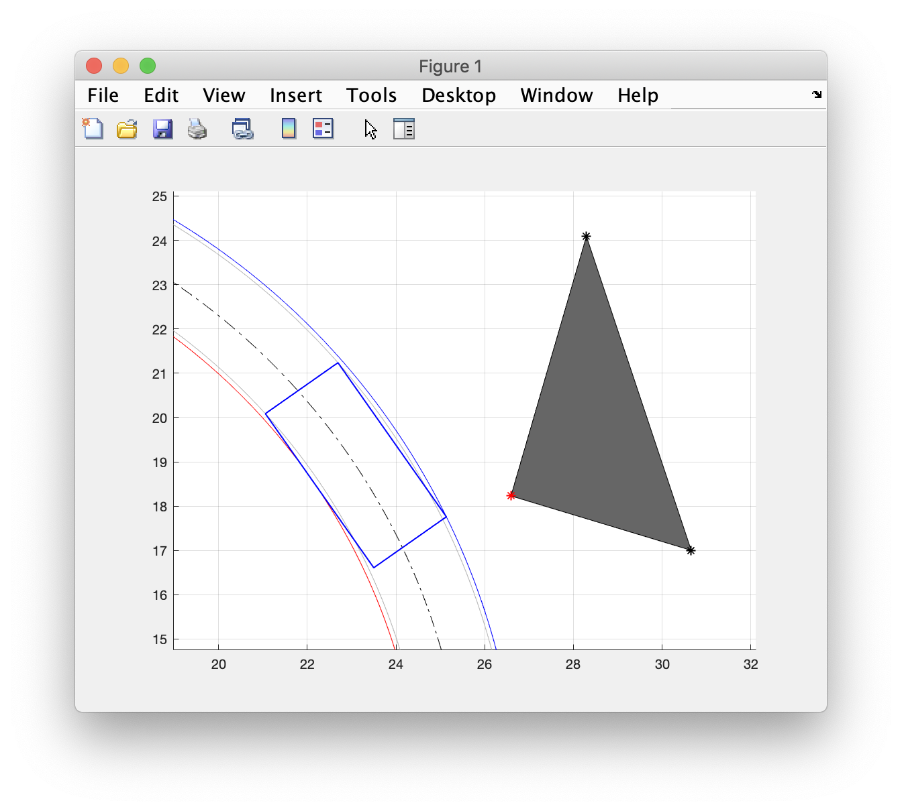
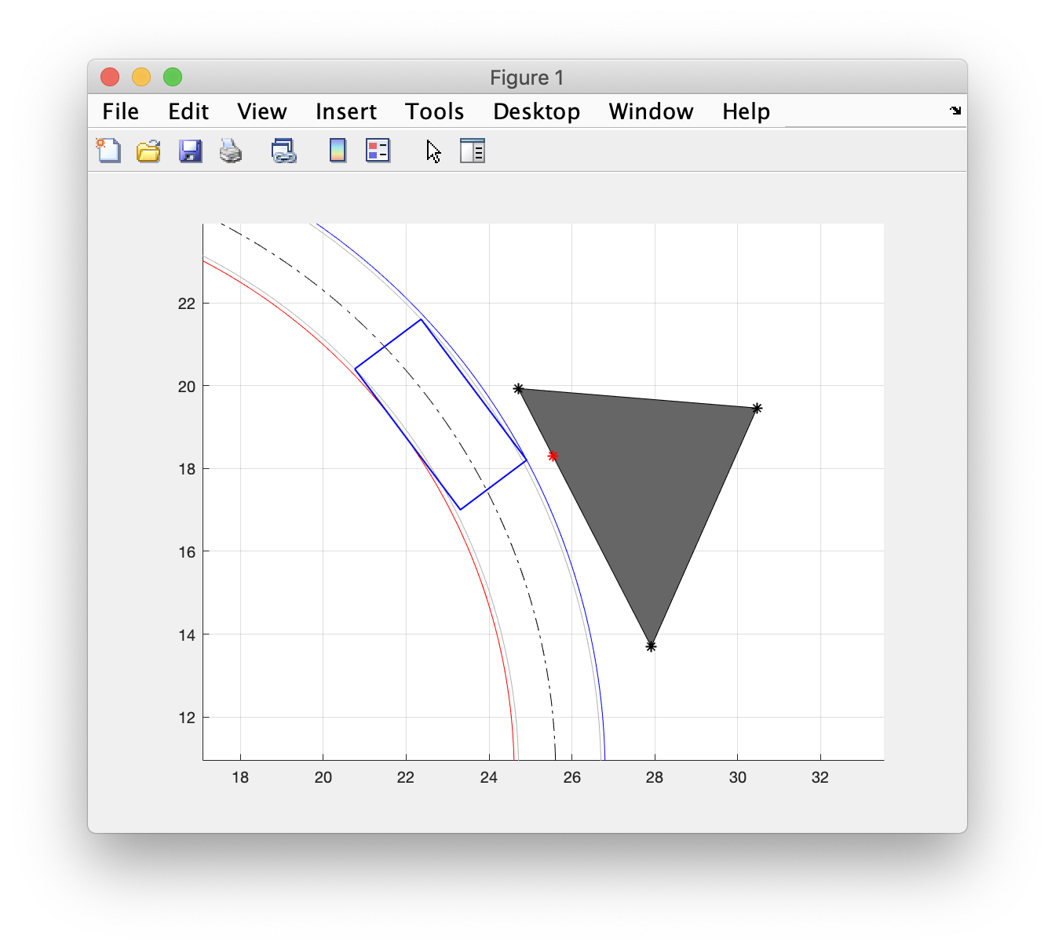
Vertices outside max/min radii (near miss)

Slide 69
References
https://www.freepik.com/free-vector/set-construction-site-objects_27285642.htm
https://www.istockphoto.com/photos/road-construction-barrels
https://www.wired.com/2017/02/self-driving-cars-cant-even-construction-zones/

